Slide 1


Improving Diversified Pricing Strategy with Machine Learning
INTEGRATED PROJECT | SUMMER 2024
Actuarial Science Program
Team Arocha
Luyang | Orange | Ruizhe
July 1, 2024
Notes:
Ruizhe-information and knowledge strategy
Orange-financial engineering
word - headings
empty slides with only headings
dot-dash
thing-evidence

Slide 2
Agenda
01 | Problem Statement | 05 | Exploratory Data Analysis
02 | Business Impact & Stakeholders Affected | 06 | Next Steps
03 | Proposed Solution Overview | 07 | Conclusion
04 | Why Machine Learning | 08 | Q&A

Slide 3














Problem Statement
Over the last few years, Columbia Insurance Company has diversified its product palette, but not its risk classification,
resulting in the use of a single loss distribution model to accommodate the pricing of all products. As a result, the pricing protocols need to be revised.
CURRENT SITUATION
Small insurance company
One property product
Single loss distribution
Aggregate loss modeling /
MC simulation
Losing competitiveness, poor results
NEW SITUATION
Substantial growth in the past five years
Multiple property products
Multiple loss distributions
Alternative pricing methodology
Want to become profitable (again)
Notes:
Aggregate Loss Modeling: Aggregate loss modeling involves estimating the total expected losses for a portfolio of risks over a specific period. This technique combines frequency and severity distributions of individual losses to predict overall financial impact.
Monte Carlo Simulation: Monte Carlo simulation is a computational technique that uses random sampling and statistical modeling to estimate the probability distribution of outcomes in a complex system. It is widely used for risk assessment and decision-making under uncertainty by simulating a large number of possible scenarios.
Exposure Rating: Exposure rating is a method used in insurance underwriting to estimate the potential losses based on the exposure of a risk, typically using historical data and actuarial techniques. It focuses on the characteristics of the risk and its probability of loss, rather than just past loss experience.

Slide 4
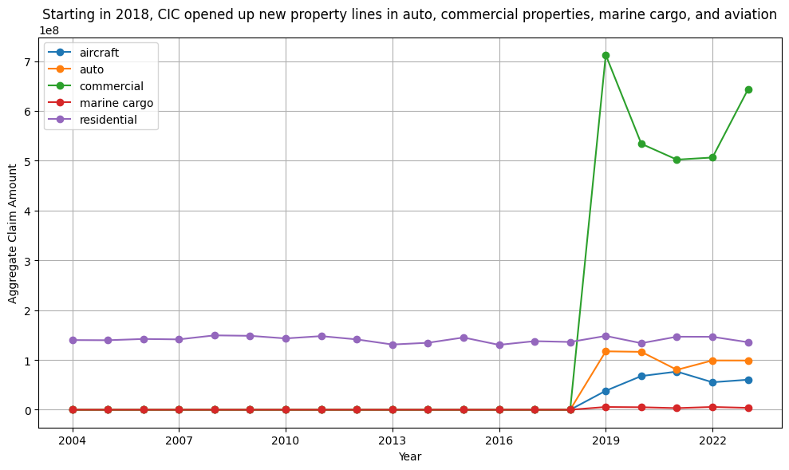
Limited Expansion in New Product Lines Indicates a Stagnant Growth Trajectory
/ 100 Million
Notes:
This period has revealed limited expansion across these newly introduced sectors, indicating a stagnant growth trajectory for these product lines within the market landscape.
aggregate claims in y axis

Slide 5
Despite Robust Growth Projections in these Sectors, The Performance of CIC Has Not Aligned With Industry Trends.
New Delhi, May 30, 2024 (GLOBE NEWSWIRE) -- The global marine cargo insurance market is anticipated to soar to US$ 34.0 billion by 2032 from US$ 20.8 billion in 2023 at a CAGR (compound annual growth rate) of 5.86% during 2024-2032.
According to Straits Research, “The global aircraft insurance market was valued at USD 14,505 million in 2022. It is estimated to reach USD 18,893 million by 2031, growing at a CAGR of 2.98% during the forecast period (2023–2031).”
The global auto insurance market size was valued at USD 652.5 billion in 2021. It is expected to reach USD 1,383 billion by 2030, growing at a CAGR of 8.7% during the forecast period (2022-2030).
The commercial property insurance industry generated US$254.9 billion in 2022 and is projected to reach US$724 billion by 2032, with a compound annual growth rate (CAGR) of 11.3% from 2023 to 2032, according to a new report from Allied Market Research.
Notes:
Despite robust growth projections across global markets for marine cargo, aircraft, auto, and commercial property insurance, the performance of CIC in these sectors has not aligned with industry trends.
(CAGR) is the annualized average rate of revenue growth between two given years

Slide 6
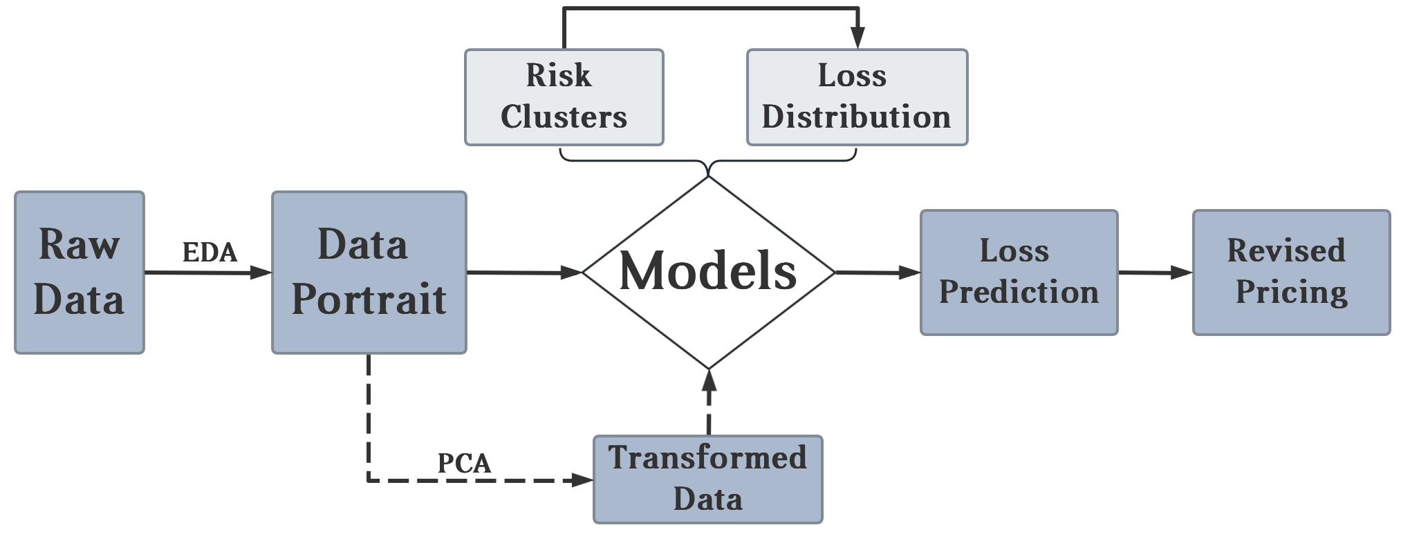
Proposed Solution Overview
Training
Testing

Slide 7
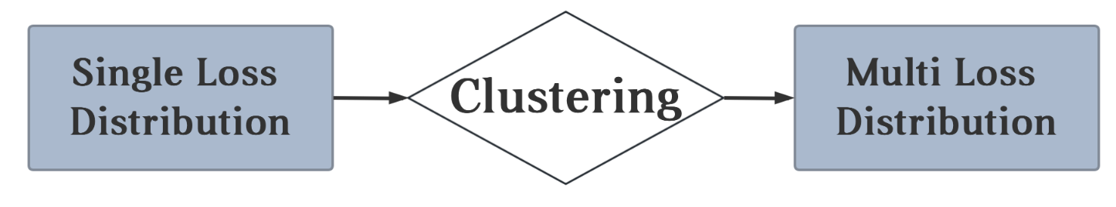
Why Machine Learning?
Old Model
New Model
Single Pricing Strategy
Stiff
One-sided
Out of Date
Tailored
Flexible
Specific
Updated
Notes:
human vs machine
cic mc simulation, aggregate loss modeling
k means clustering, unsupervised machine learning

Slide 8

Exploratory Data Analysis
Clean
Drop Invalid Data point:
Remove useless data
Reduce distractions
Remove Dirty/Abnormal Value:

Slide 9
Exploratory Data Analysis
Analysis
Ensure data quality
Understand data distribution and relationship
Identify significant patterns

Slide 10
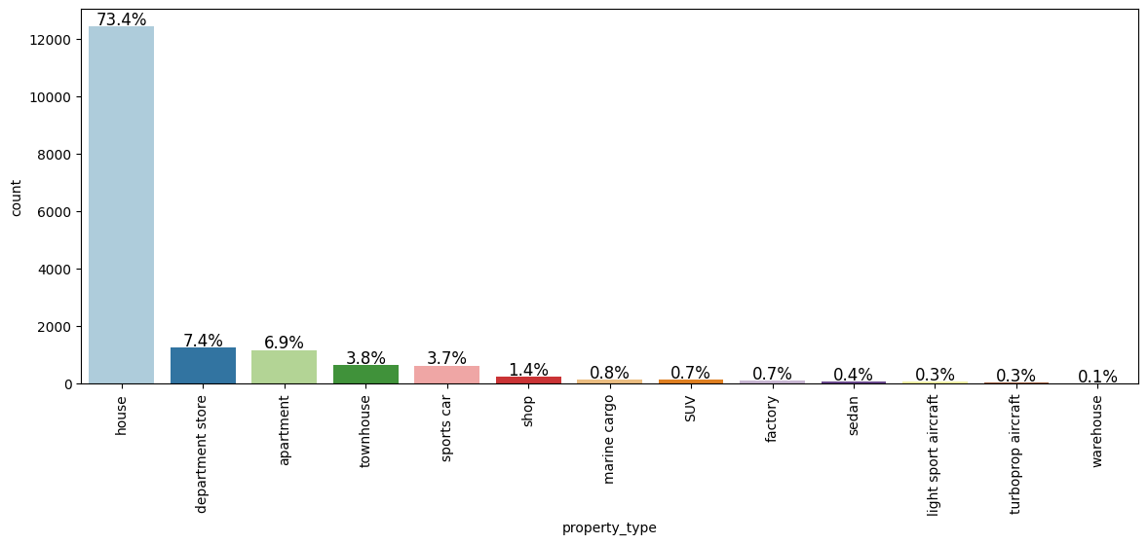
Most Policies Are For Houses
Notes:
Header: Most of the policies are in homer owner’s insurance for Houses

Slide 11
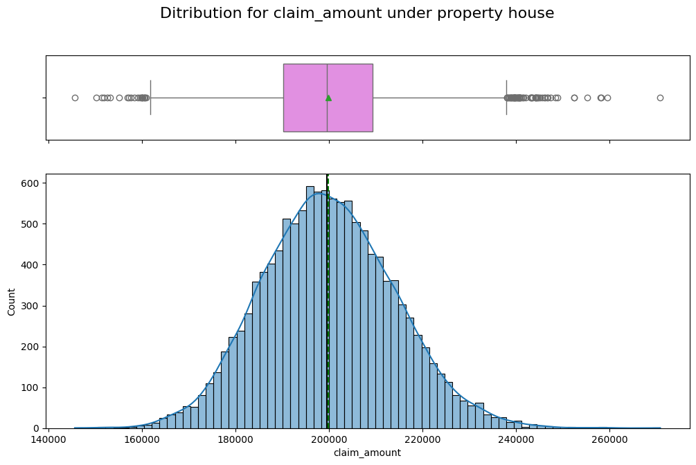
Normal Distribution Of Houses Claim Amount

Slide 12
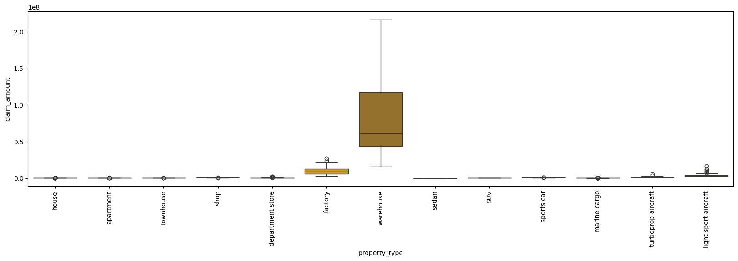
Larger Claim Amount For Warehouses/Factories

Slide 13
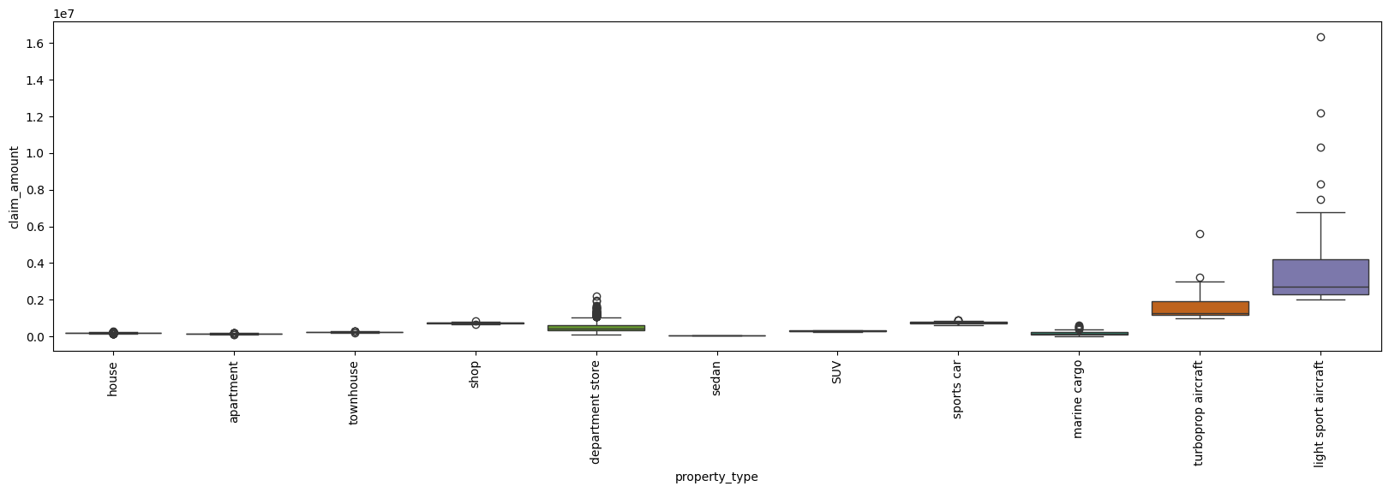
Difference Among Small Claim Amount

Slide 14
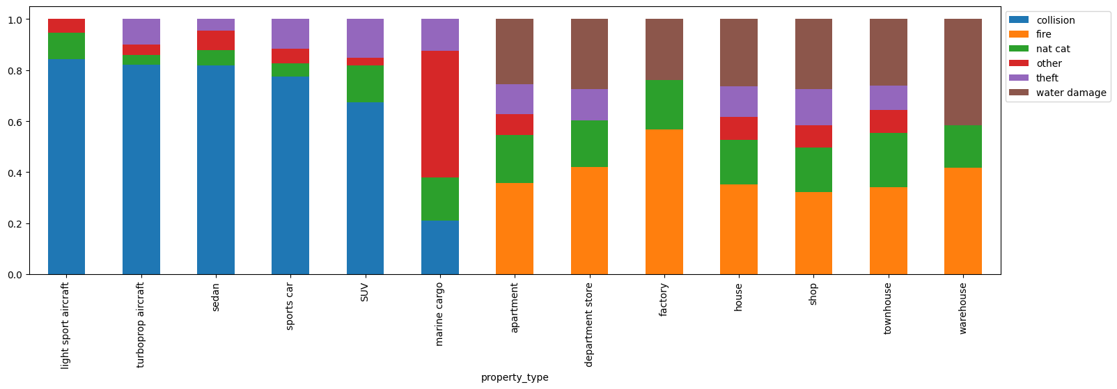
Incident Types Differ Among Properties

Slide 15
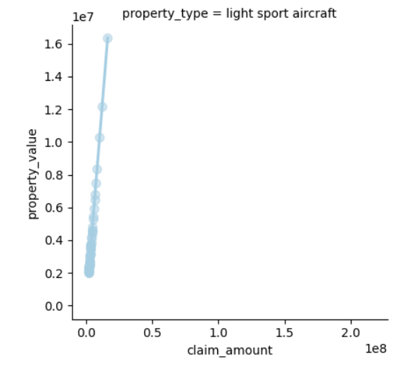
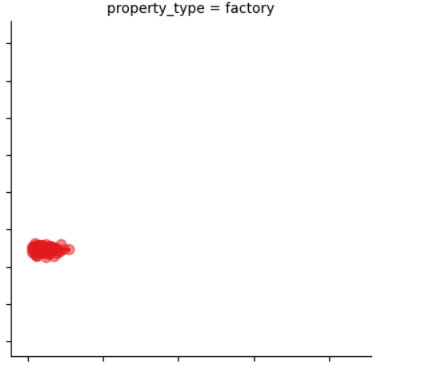
Different Correlation For Different Properties

Slide 16
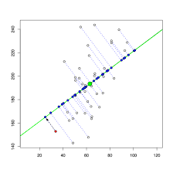
Next Steps
Principal Component Analysis
Dimensionality reduction
Noise reduction
Improve clustering
Identify key patterns

Slide 17
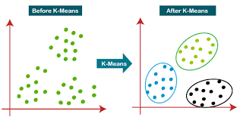
Next Steps
K-Means Clustering
Classify data points to K classes based on distance between data points
Trained/Tested on historical data
Works for future data
Notes:
cluster: new risk classes for each product

Slide 18
Next Steps
Exposure Rating
Loss analysis
Exposure measurement
Expected loss calculation
Develop loss elimination ratio (LER) curve
Premium decision
Future adjustment
Notes:
We don’t have enough data points,

Slide 19
Conclusion

Slide 20
Q & A
THANK YOU
Notes:
claim 20 yrs ago, adjust for inflation? the data file we got is already adjusted for inflation for 2024.

Slide 21
Appendix
Marine Cargo Growth https://finance.yahoo.com/news/marine-cargo-insurance-market-set-133000167.html
Commercial Property Growth https://www.insurancebusinessmag.com/us/news/breaking-news/commercial-property-insurance-market-to-hit-us724bn-by-2032-458055.aspx#:~:text=The%20commercial%20property%20insurance%20industry,report%20from%20Allied%20Market%20Research.
Auto Growth https://straitsresearch.com/report/auto-insurance-market#:~:text=The%20global%20auto%20insurance%20market,of%20an%20accident%20or%20theft.
Aviation Growth https://finance.yahoo.com/news/aircraft-insurance-market-size-expected-143500313.html

